Slide 1



Competence-based
medical education and training (CBMET)
Sibylle A. Langenecker (previously Kietaibl) M.D. Prof. M.B.A.
Department of Anaesthesia and Intensive Care
Evangelical Hospital Vienna
Sigmund Freud Private University Vienna
Danube University Krems
www.perioperativebleeding.org
sibylle.kietaibl@aon.at
Delegate of ÖGARI in European Board of Anaesthesiology (EBA)
Chair, Standing Committee, Education & Professional Development
Notes:
1

Slide 2
Declaration
potential conflicts of interests:
none
fotos: a.o. from google.at

Slide 3
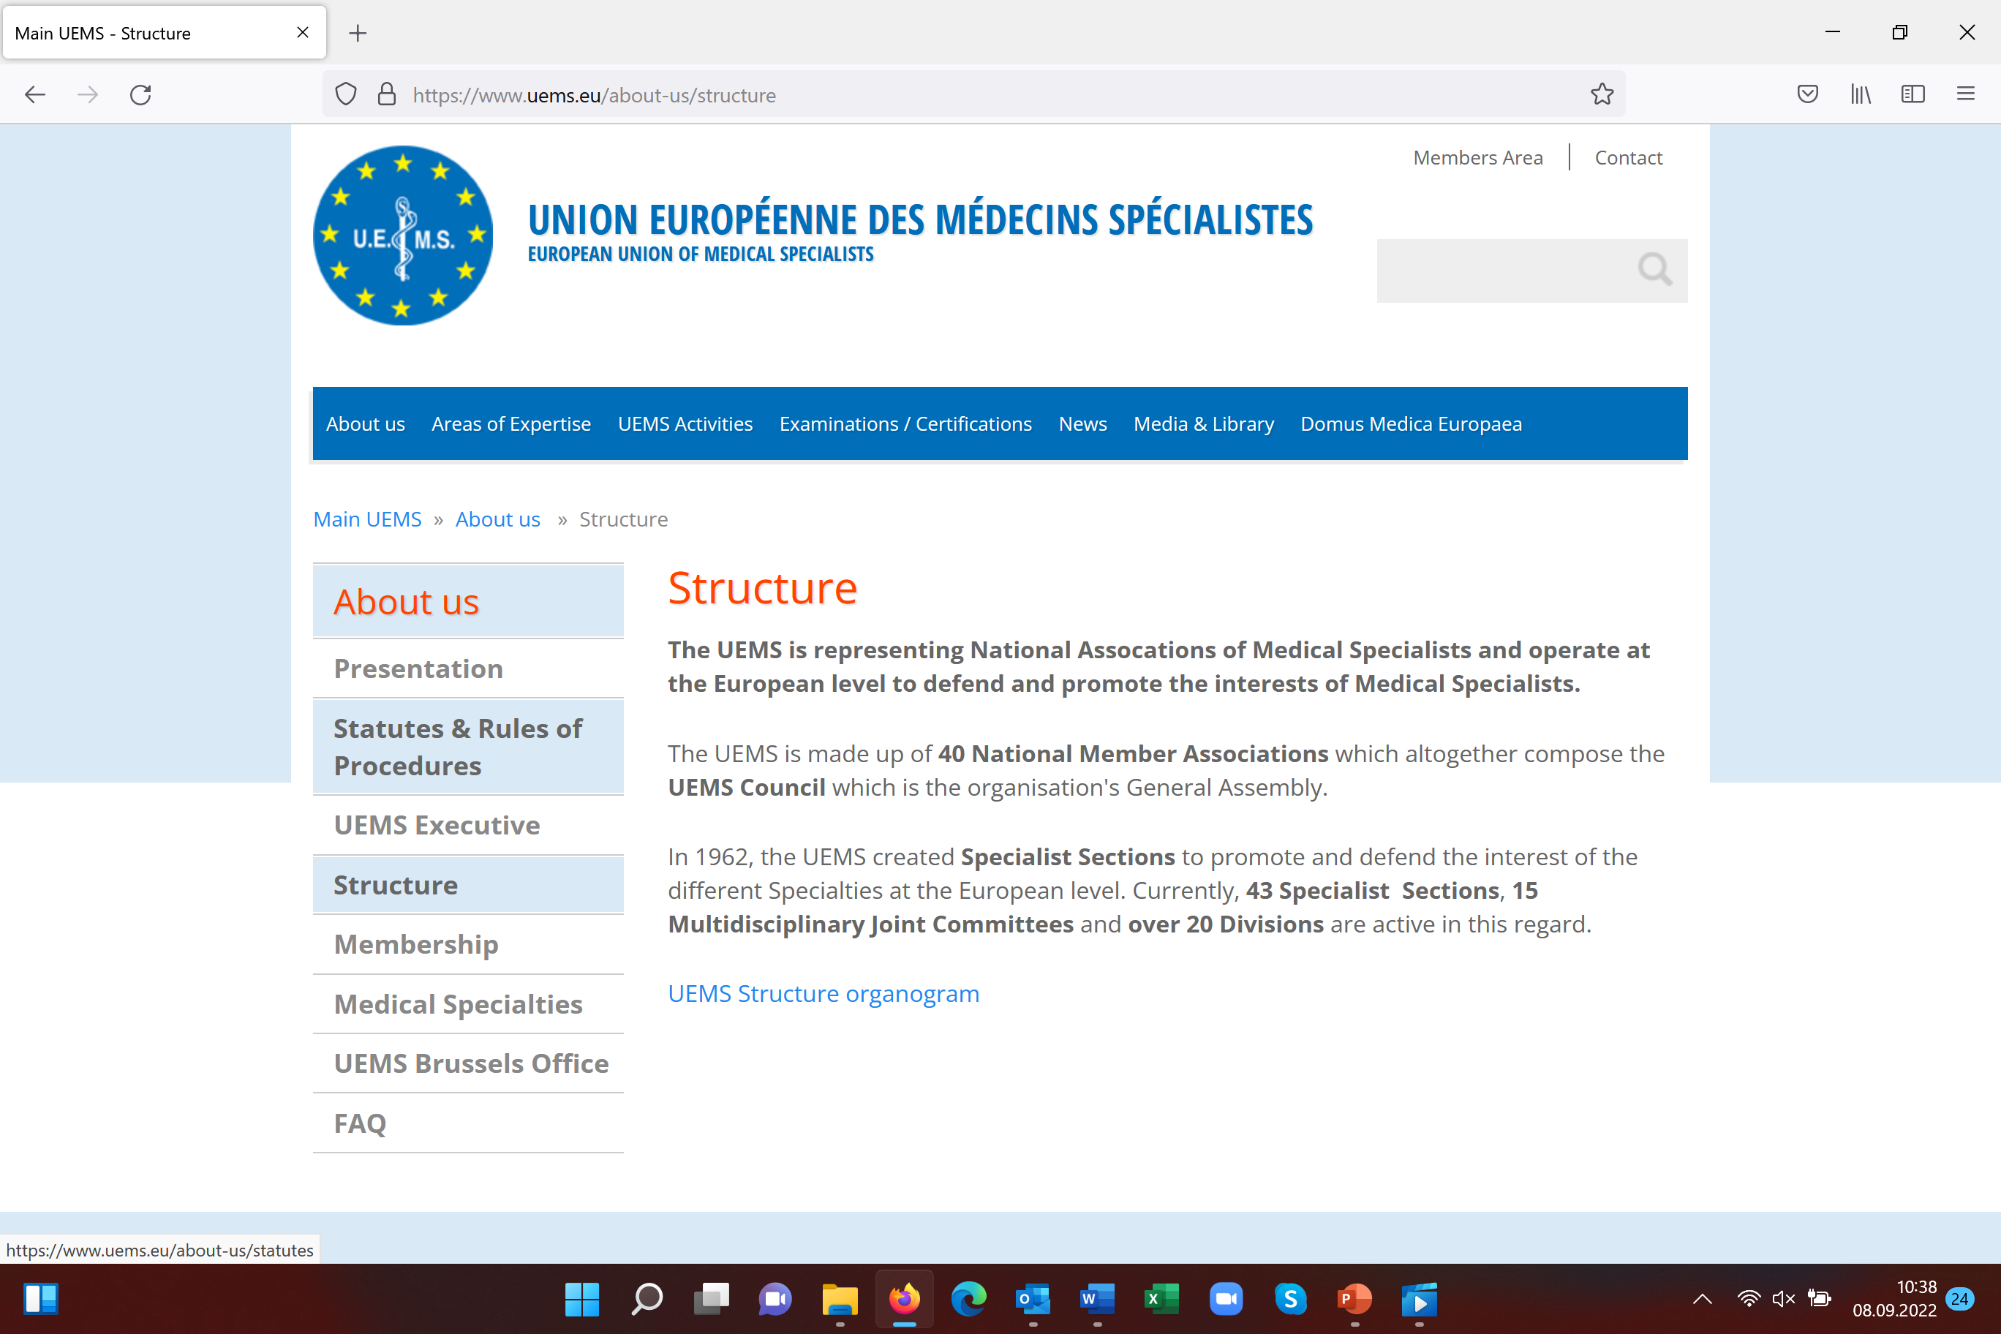

Slide 4
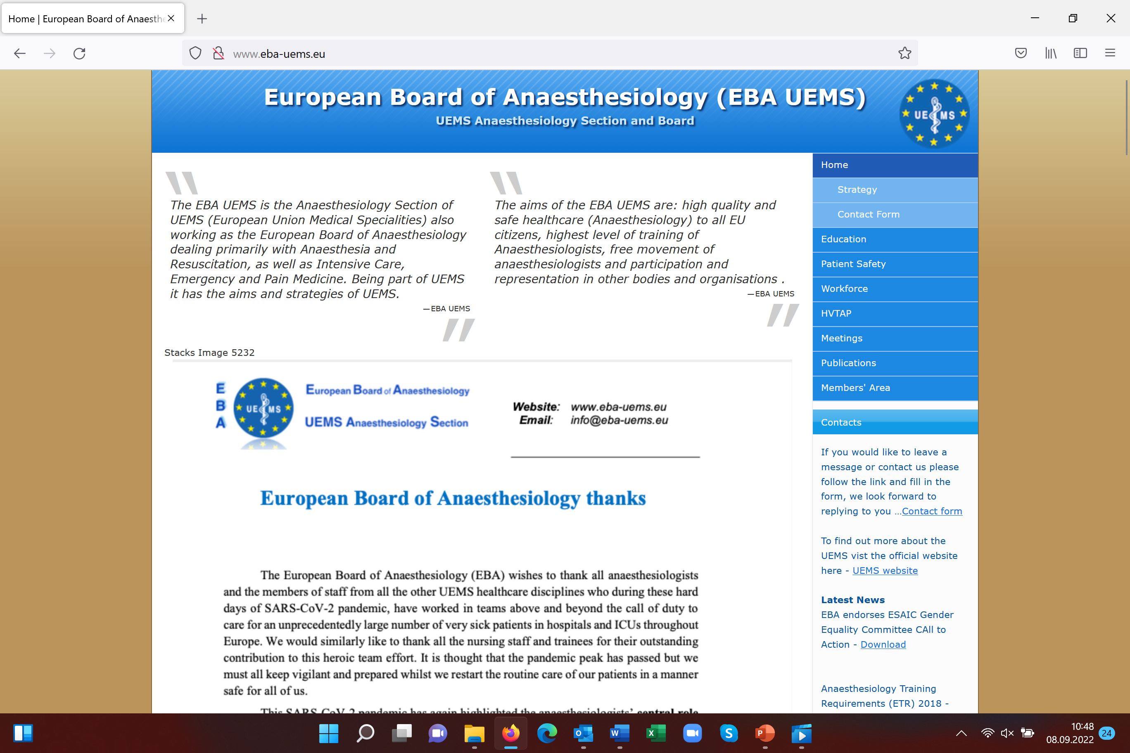

Slide 5
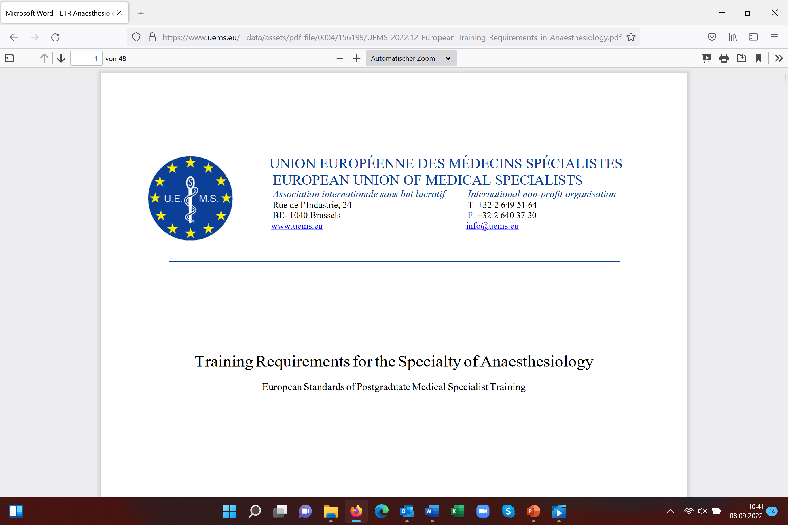

Slide 6

ETR
European Training Requirements
UEMS basic principle is competence-based (CBMET),
not number- or time-based

Slide 7
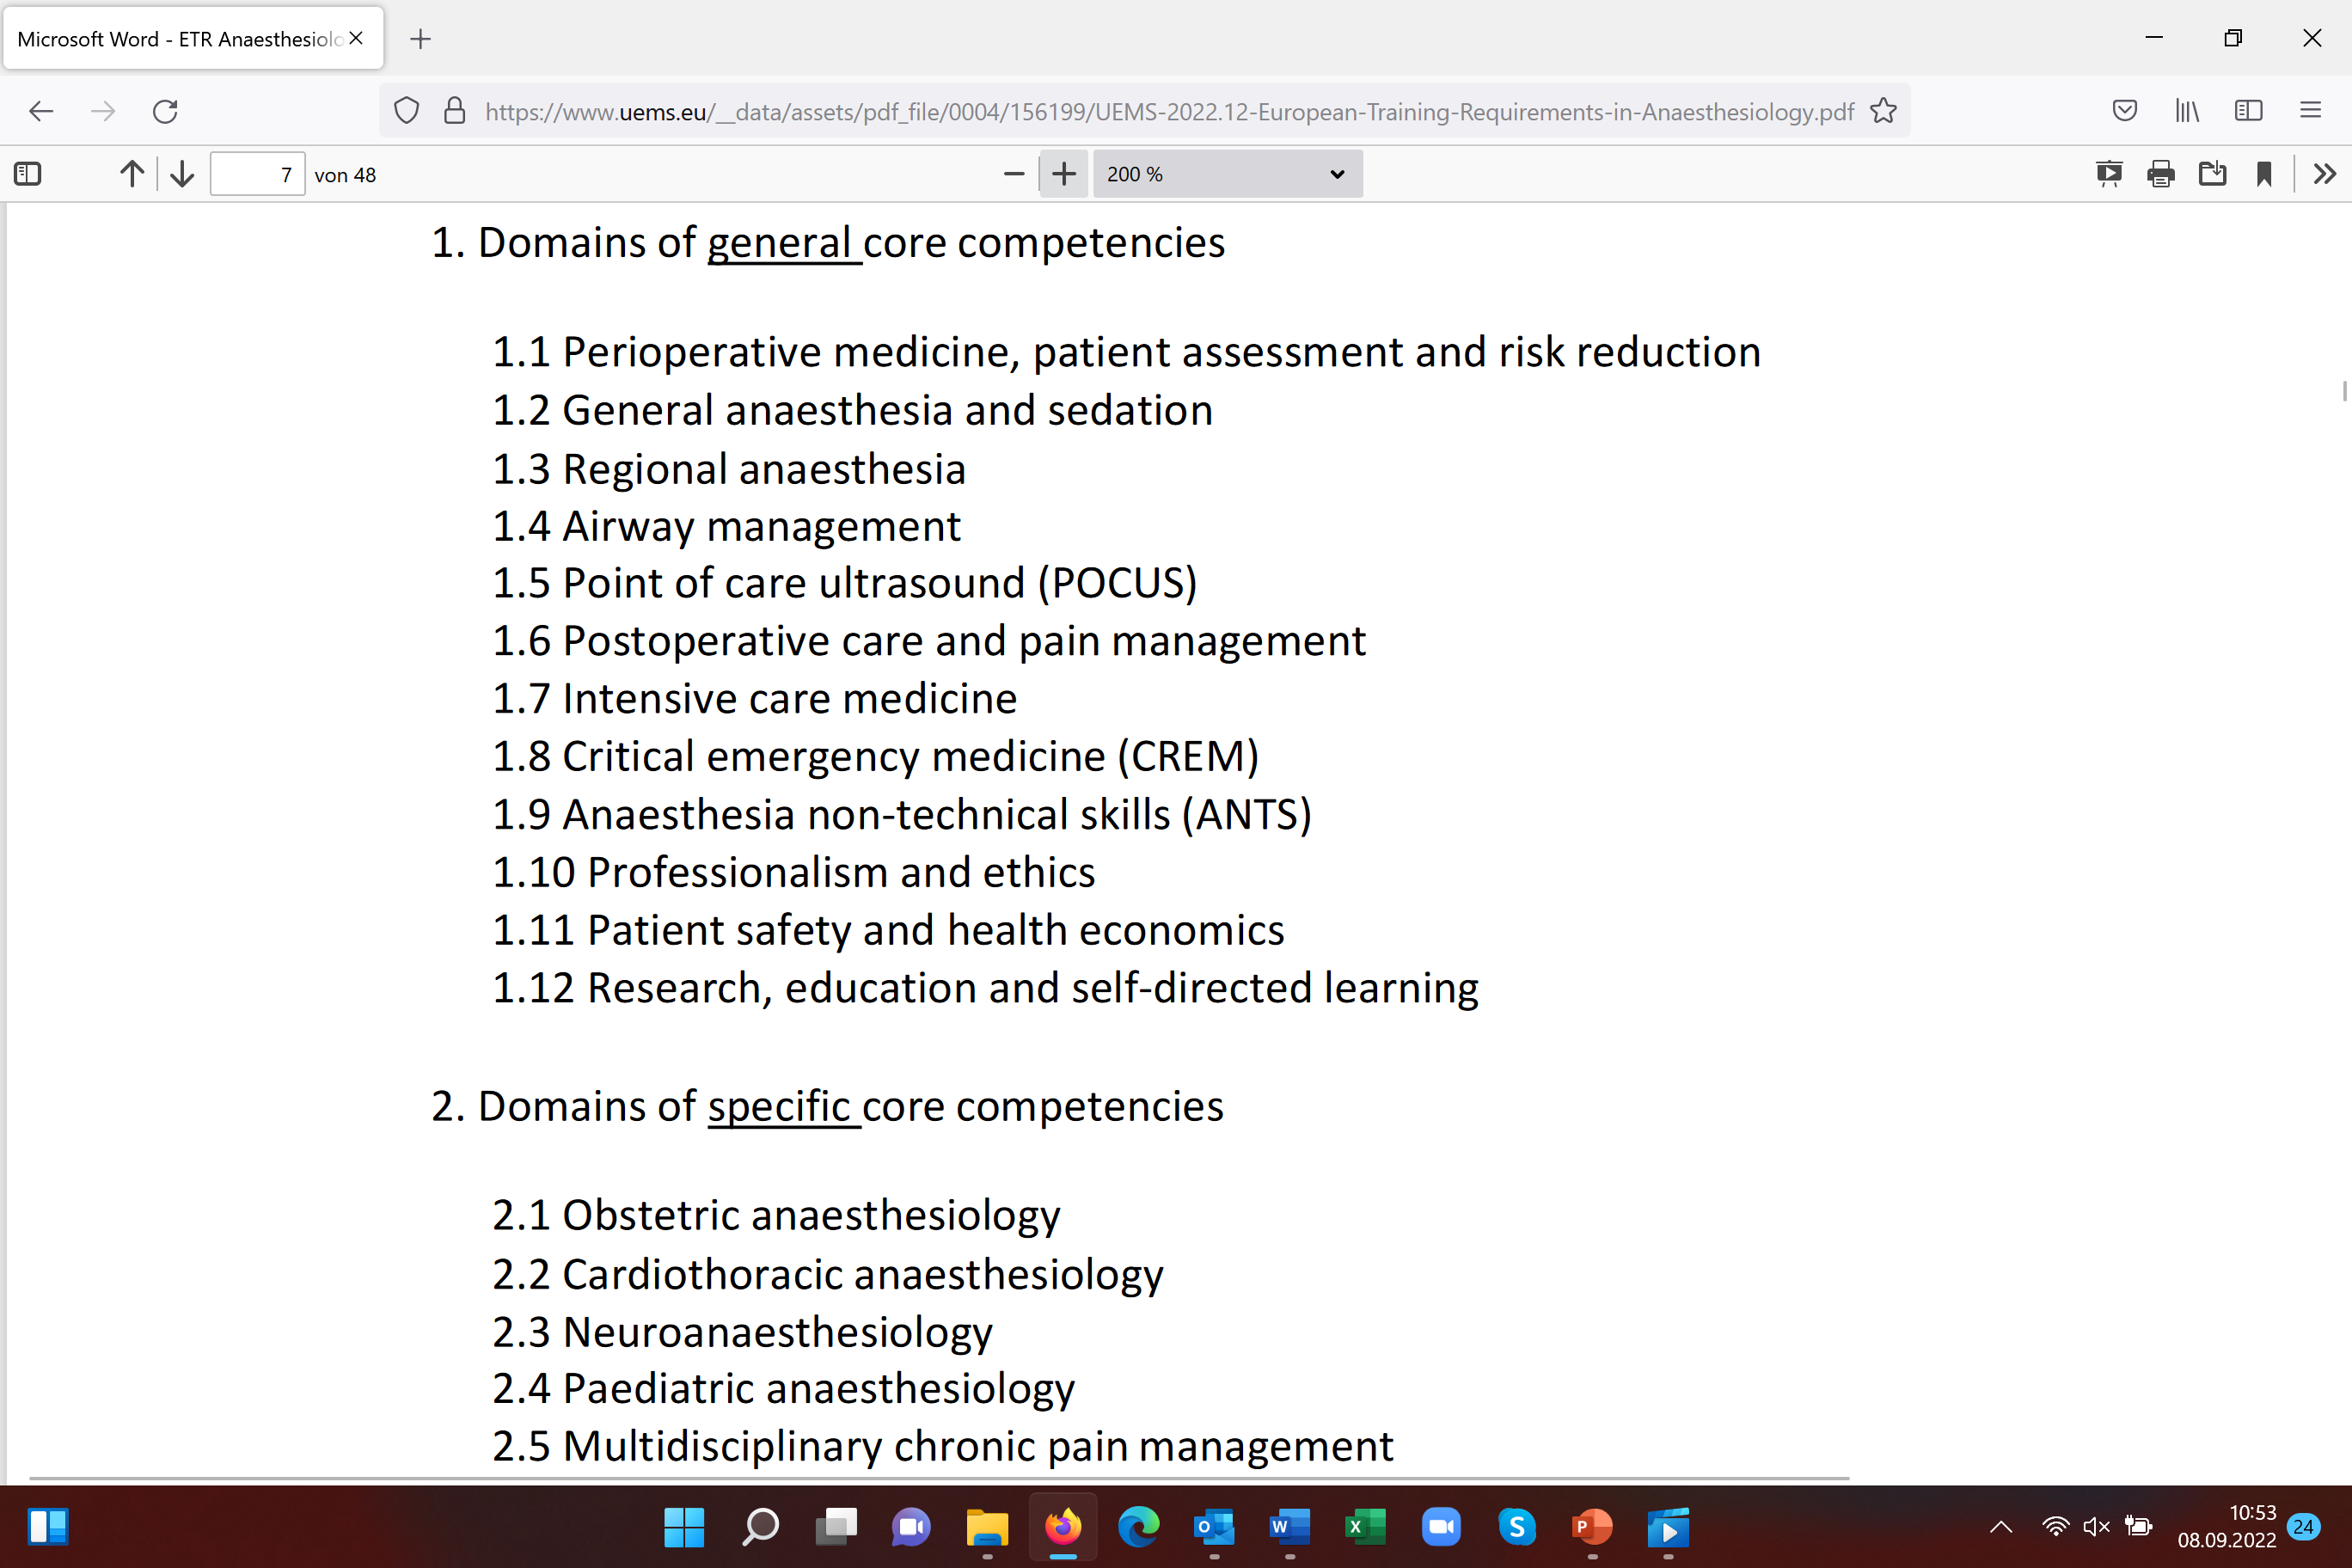

Slide 8

CBMET
target is to reach predefined training outcomes
oriented on patient needs
skill / competence goals to measure and assess
focused on learning-outcome, on the effect of training
individualised training process
count-variable, time-variable, but minimum training duration defined

Slide 9
CBMET training methods
Feedback
Assessments
Progress to tasks with increasing competence requirements

Slide 10
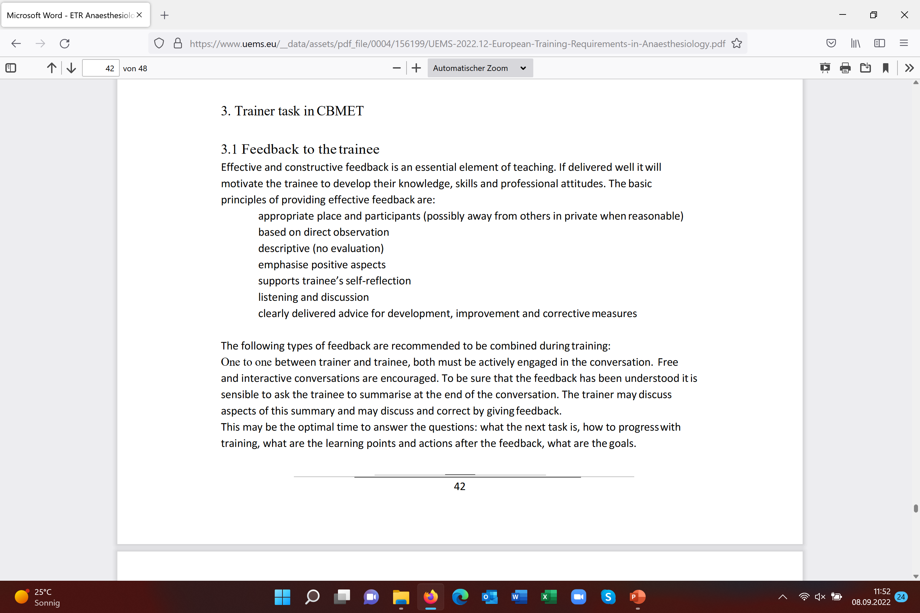
trainer – trainee, multi-consultant, multi-source

Slide 11
Assessments in CBMET
summative assessments
to test achievement of certain levels
formative assessments
giving feedback and advice to support learning
close the gap between learning and applying
progress assessments
by variety of tools including WBA, EPA

Slide 12
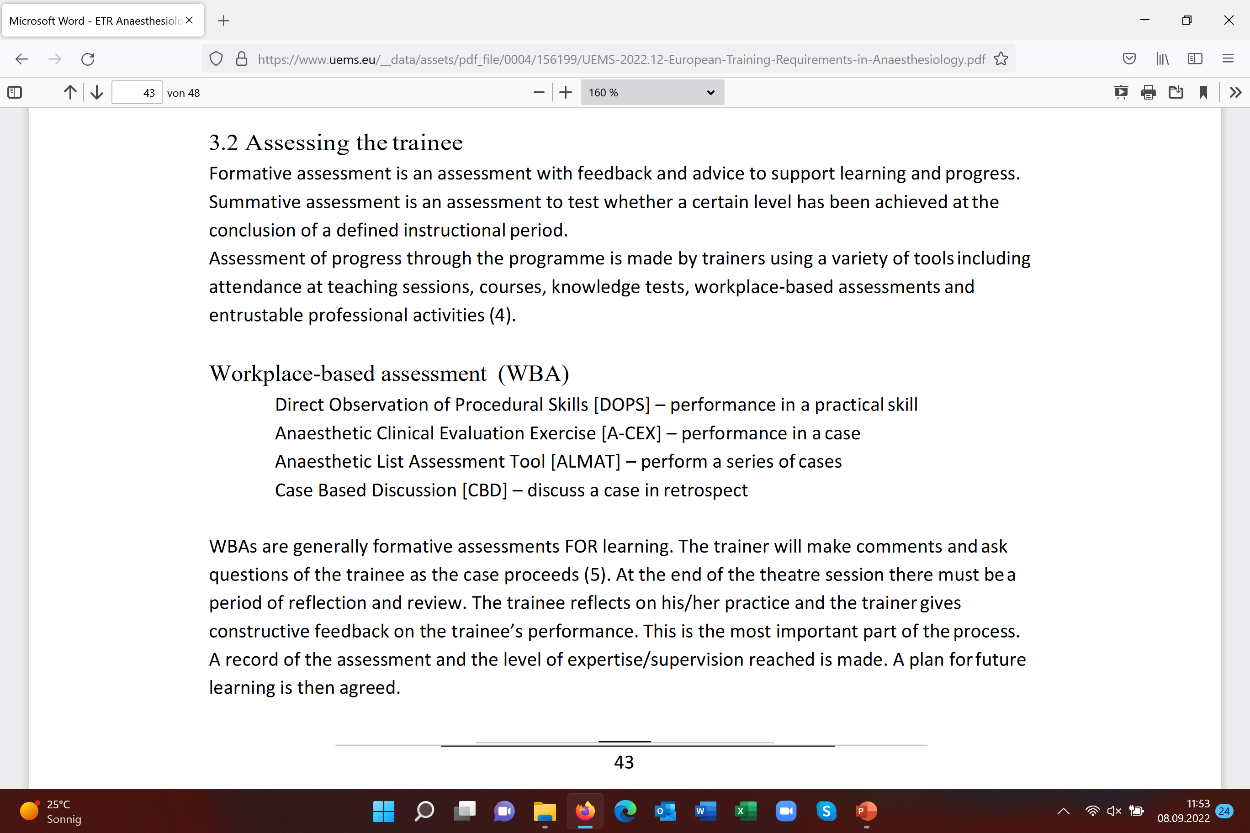

Slide 13
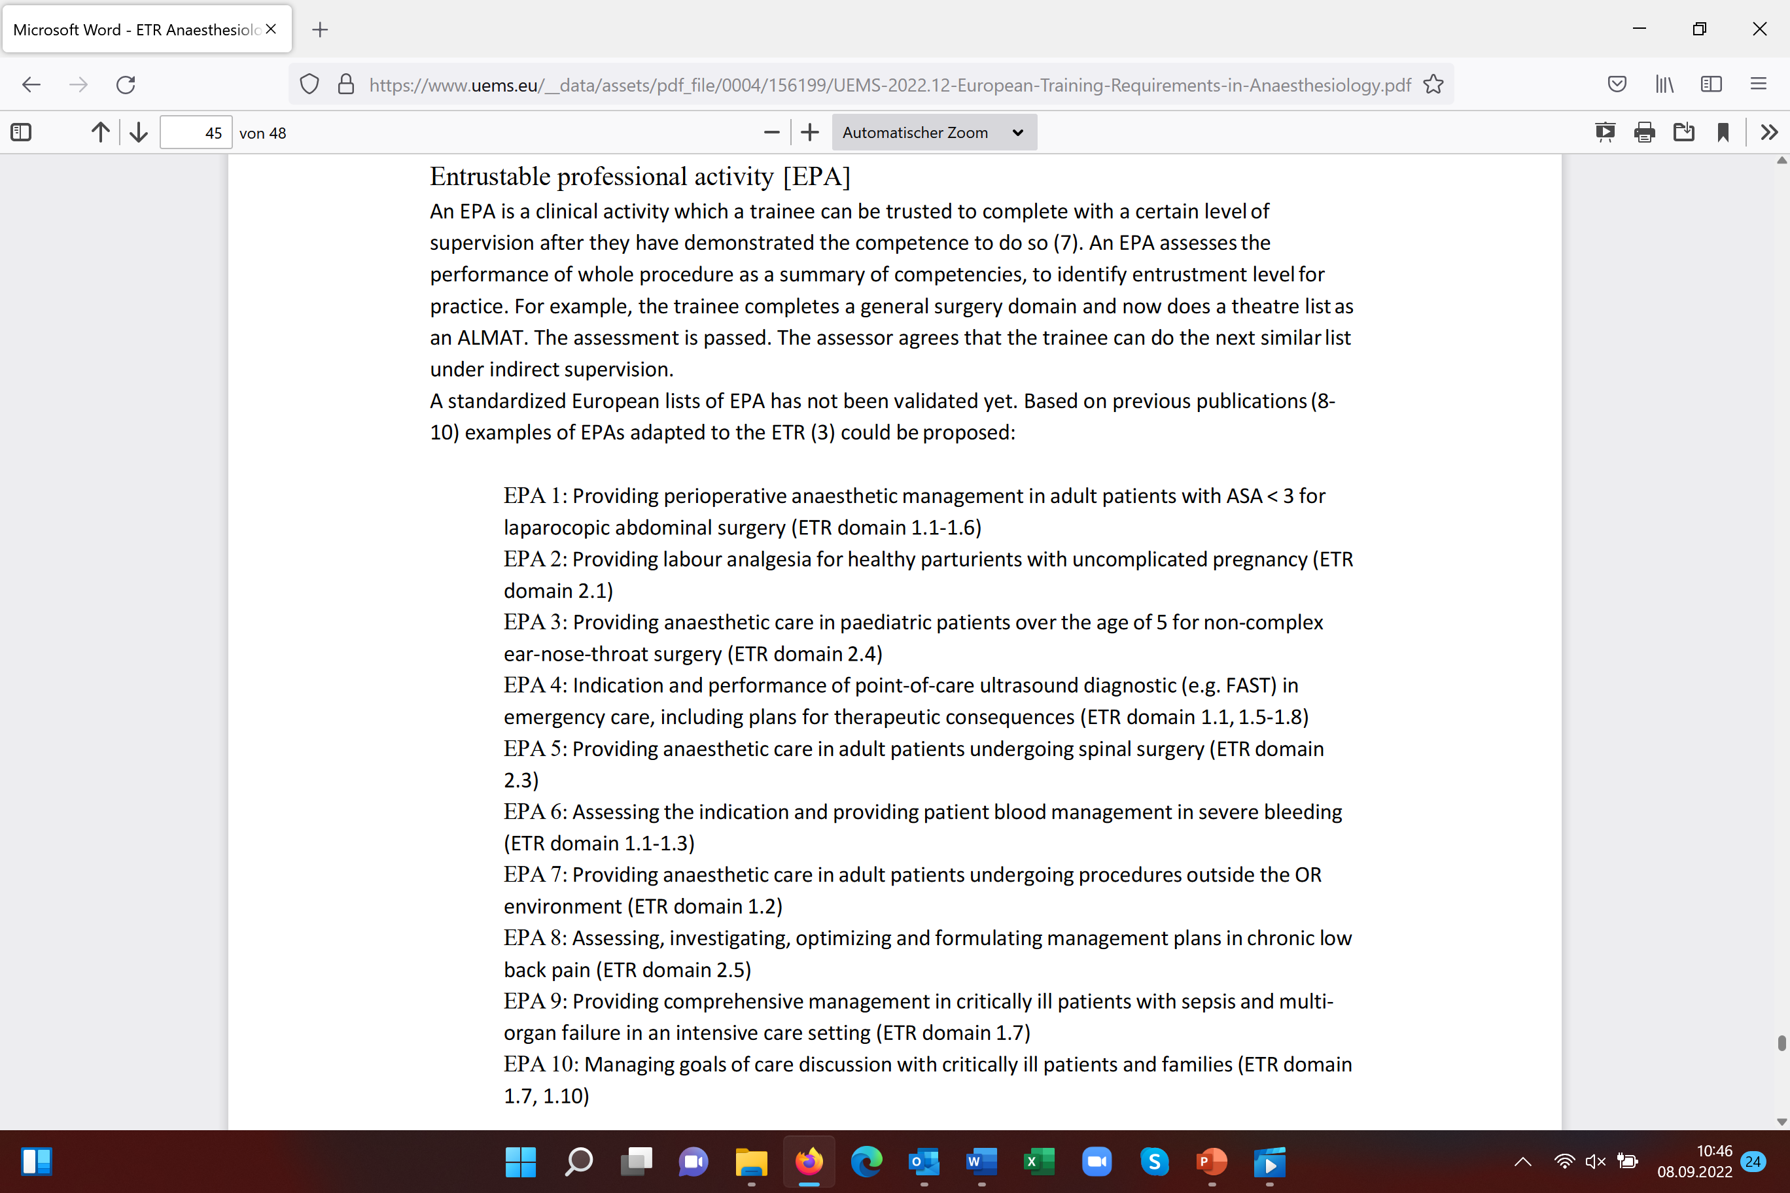

Slide 14
ETR of UEMS is not a law
national authorities of EU member state
decide on accreditation and training concept
Notes:
14

Slide 15

CBMET: competitive advantage
hospitals with CBMET are attractive
for trainees
migration of joung doctors
Kietaibl S, Blank A, De Robertis E. Medical training in anaesthesiology. Updated European
requirements. Eur J Anaesthesiol 2019;36:473-6

Slide 16

Trainee Corner:
Challenges and transformation of
Anaesthesiology and Intensive Care Training in Europe
Dr. Igor Abramovich and Prof. Dr. Sibylle Kietaibl
1.2.2022, S01 E01
Notes:
16

Slide 17
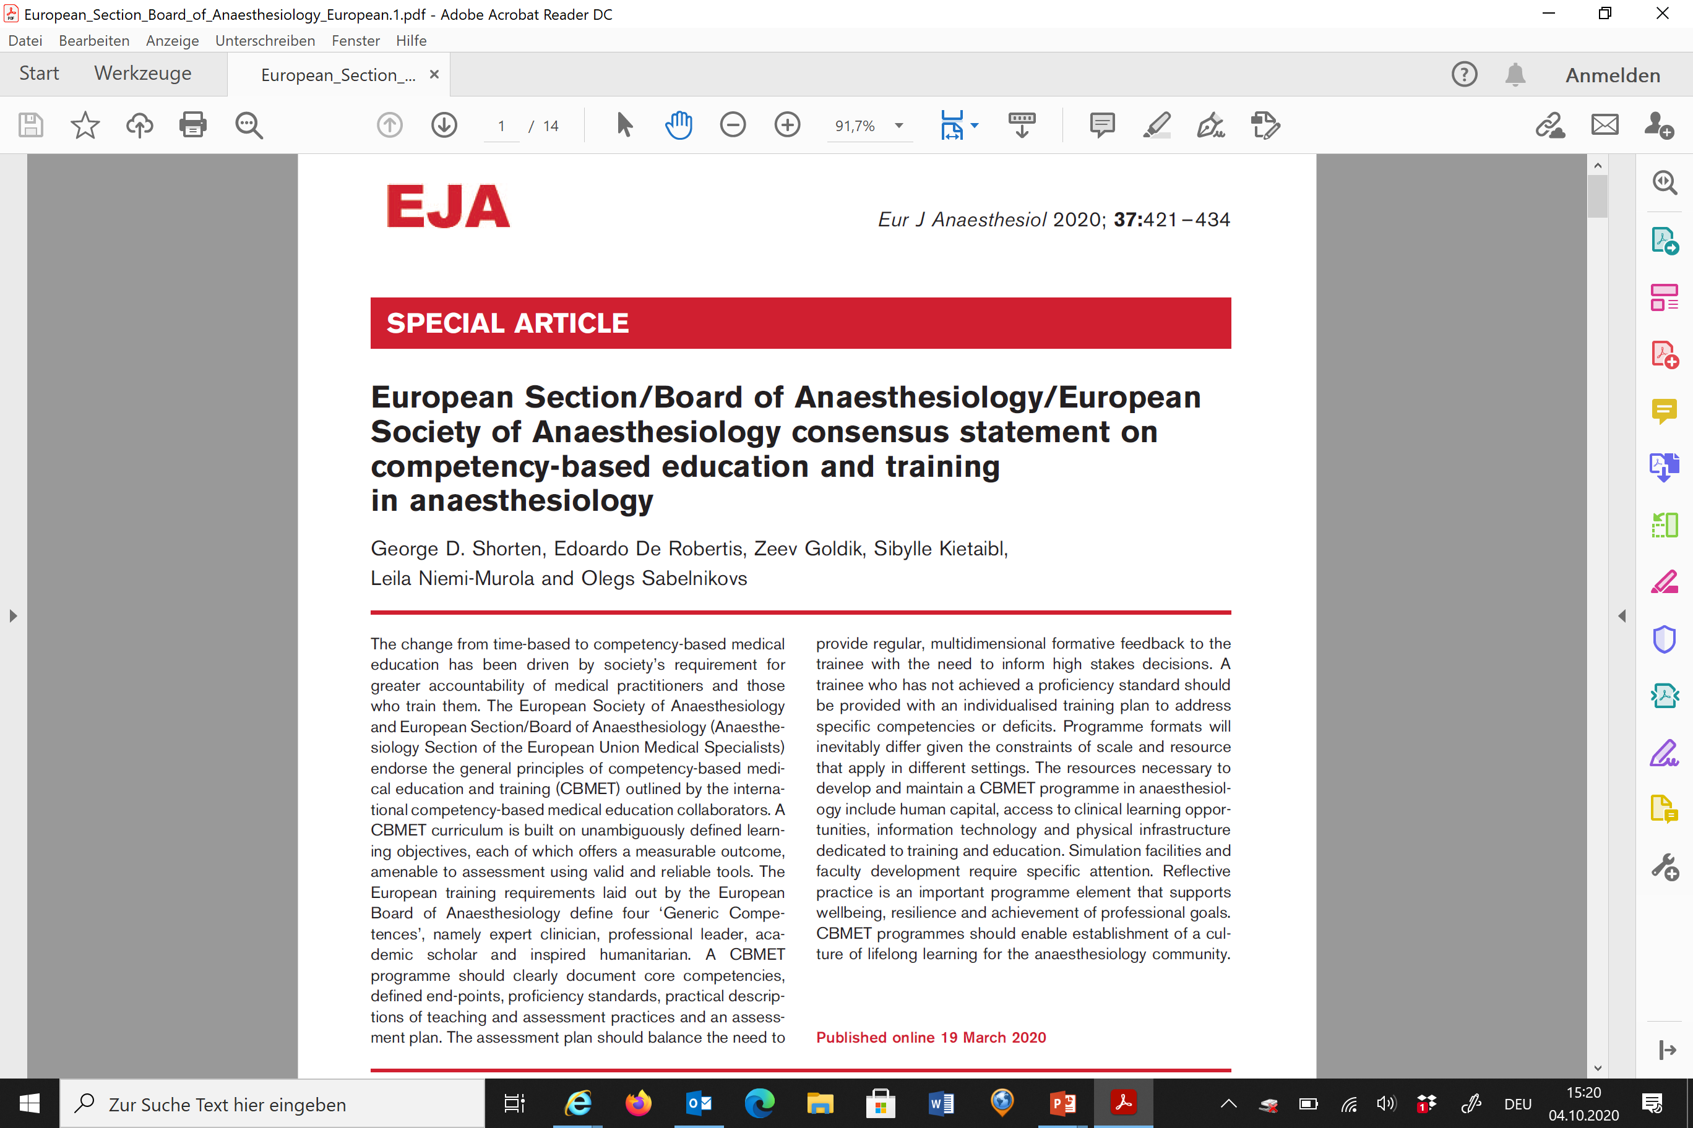

Slide 18
from transition to discipline,
to the core of discipline,
to transition to practice,
to professional development

Slide 19

Professional development (PD)
in many European countries:
compulsory CME-based accreditation system

Slide 20
room for improvements
appraisal of medical simulation training,
hospitation, interactive learning sessions
… count-based PD accreditation,
but not competence-based

Slide 21
CBMET: competitive advantage
hospitals with CBMET are attractive
for trainers
job-enrichment, binding specialists to an institution with
competence-oriented microclimate
Van den Berg J, Mastenbroek N, Scheepers R et al. Work engagement in health
professional education. Med Teach 2017;39:1110-8

Slide 22
Occupational stressors in Anaesthesiology
Saadat H, Kain Z. 2018.www.co-anesthesiology.com
Complexity of clinical tasks
Hugh clinical responsibility
Fear of harming the patient
Communication difficulties
Lack of job control
Time constraints
Work overload
Production pressure
Workplace atmosphere
Notes:
22

Slide 23
Societal impact of physicians wellbeing
Performance
Productivity
Recruitment
Absenteeism
Job turnover
Early retirement
Reduced revenue
Patient‘s safety, devotion to patients
Notes:
23

Slide 24
tool-box for occupational wellbeing

Slide 25
Clinical skills in ETR update 2022:
Medical communication
b. Practical and clinical skills
Skills uniform in all clinical settings are only described here but apply throughout the ETR:
…
Communication
  effective
  clear and unambiguous
  closed loop
  methods (verbal, written, consultation or referral)
  manner (courtesy, integrity, respect)
  with patients and their relatives, including patients with impaired capacity and language barriers
  with other health care providers D

Slide 26
Learning bullet points:
Competence-based medical education & training (CBMET)
Evidence-based concept recommended by ESAIC and EBA
independent from duration / years of specialist training or
counts of exposure but dependent on
trainees‘ individual progress towards pre-defined training outcomes
closes the gap between learning and applying by
summative assessment of learning, formative assessment for learning
feedback (trainer-trainee, multi-consultant, multi-source)
workplace-based assessment (WBA)
hospital-internal Entrustable Professional Activities (EPAs)

Slide 27
Suggestions to:
Standing Committee
Education & Professional Development EPD
of the EBA UEMS
sibylle.langenecker@aon.at
Notes:
27

